Slide 2
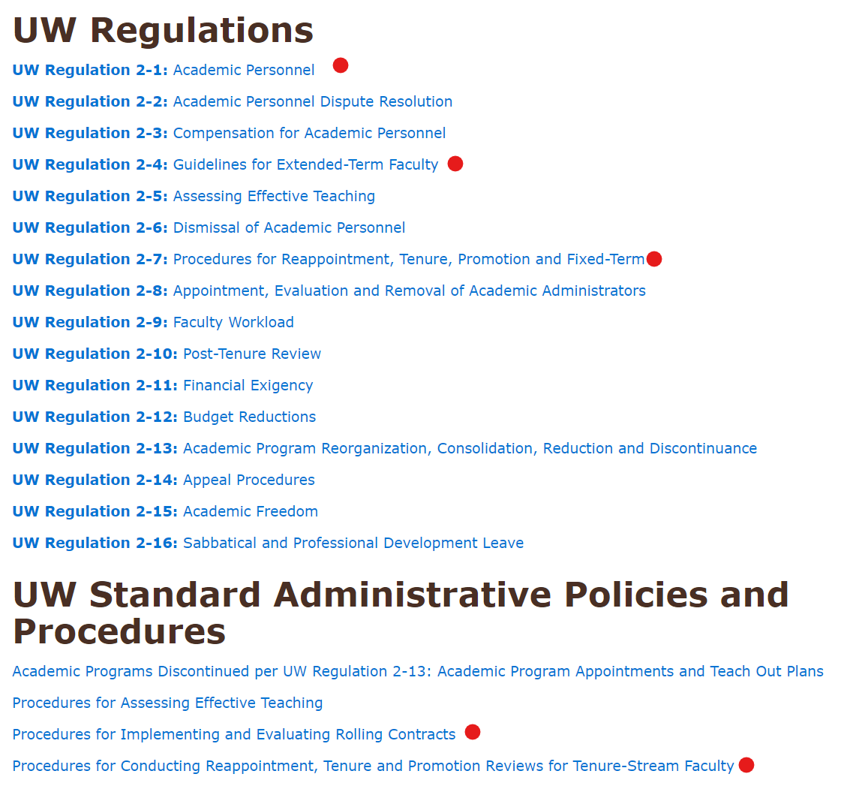
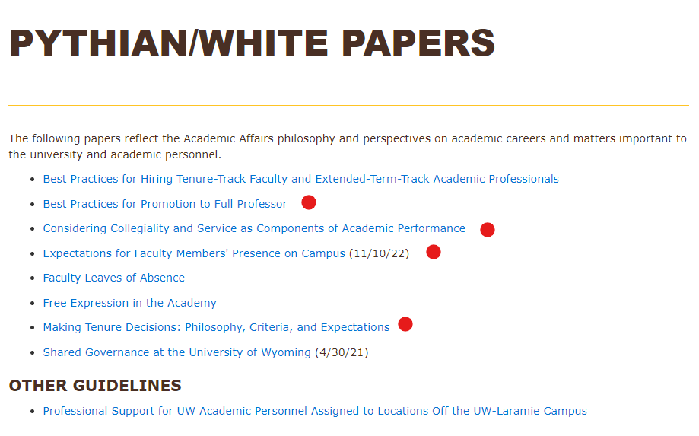
University Regulations, Standard Administrative Policies and Procedures (SAPs), and Expectations
Coming Soon!
Best Practices for Considering Community Engagement as a Component of Academic Performance
Best Practices for Considering Innovation and Entrepreneurship as Components of Academic Performance
Department Expectations

Slide 3
Typical Tenure Track Faculty Career Path
Tenure and promotion to Associate Professor, or termination
Mid-probationary (progress toward tenure) review
Ongoing excellence and impact through research, teaching and service;
Greater level of accomplishment and intellectual leadership
is expected
6
Probationary Period*
0
3
Additional Period of Growth
Beginning AY23-23, all 1st year reviews will be conducted during annual review cycle.
Annual Review
Promotion to Professor (optional)
Hired as Assistant Professor
* Faculty are on annual appointments during the probationary period. A review may result in recommendation to reappoint or terminate.

Slide 4
Typical Fixed Term with Rolling Contract Track Faculty Career Path
Probationary Period
Year 1
Year 2
Year 3
Annual review*
Review for 3 or 5 yr fixed term rolling contract
Annual review*
* Annual review procedures consistent with unit and college protocol. Beginning AY 23-24, all 1st year reviews conducted during annual review cycle.
Non-tenure track faculty will normally be considered for promotion after six years.

Slide 5
Standard Administrative Policies and Procedures for Conducting Reappointment, Tenure, and Promotion Reviews Changes in AY 2023-24
Peer Group: Must include at least faculty at rank or higher than the position for which the candidate is being reviewed.
Peer group composition shall apply consistently across candidates.
Candidates may not choose different peer group compositions.
Peer groups for FTRC reviews must parallel these procedures.
Adding Materials to the Case File: Record may be updated (e.g., new publications, artistic productions, grants, etc.) after each level of review.
Updates may be included in candidate response.
Units/colleges will not upload a new version of the CV (generated from WyoVita) for this purpose.
Meeting with URTP Committee: Candidates will be invited to meet with URTP Committee only when committee deems it necessary.
If invited, the department head and dean are expected to attend as well.
If not invited, neither department head nor dean will attend.

Slide 6
Standard Administrative Policies and Procedures for Conducting Reappointment, Tenure, and Promotion Reviews Changes in AY 2023-24
4. “Early” Tenure and/or Promotion: Written concurrence of the majority of voting faculty prior to initiating candidacy is no longer required.
Department Heads may consult informally with voting faculty.
5. Summary Report for Provost: The Provost may request an evaluative summary about the quality and quantity of scholarly productivity, including public scholarship and engagement projects where appropriate, teaching, service, and extension where appropriate. For promotion, summary should provide evidence of significant accomplishments and impact.
6. Confidentiality Acknowledgement: Although confidentiality is not a new expectation, all faculty will complete a confidentiality acknowledgement form before participating in any aspect of the review process.

Slide 7
Revised Timeline for Reviews
Date | Event
May 25, 2023 | Department heads and candidates for promotion complete preliminary process for selecting external reviewers.
September 15, 2023 | All materials, including external reviews, must be completed and uploaded to case files in WyoFolio.
September – December, 2023 | Department and college reviews completed in accordance with the college’s internal deadlines.
January 5, 2024 | All mid-probationary, tenure, fixed-term rolling contract, and promotion reviews must be completed. Deans forward cases in WyoFolio to Academic Affairs.
January 19, 2024 | All cases reviewed by Academic Affairs and the docket for URTP Committee is finalized.
February 5-6, 2024 | URTP Committee meets to deliberate cases.
March 2024 | Provost recommends mid-probationary and 3-year FTRC cases to President. Tenure, promotion, and 5-year FTRC of recommendations to President and Board of Trustees.

Slide 8
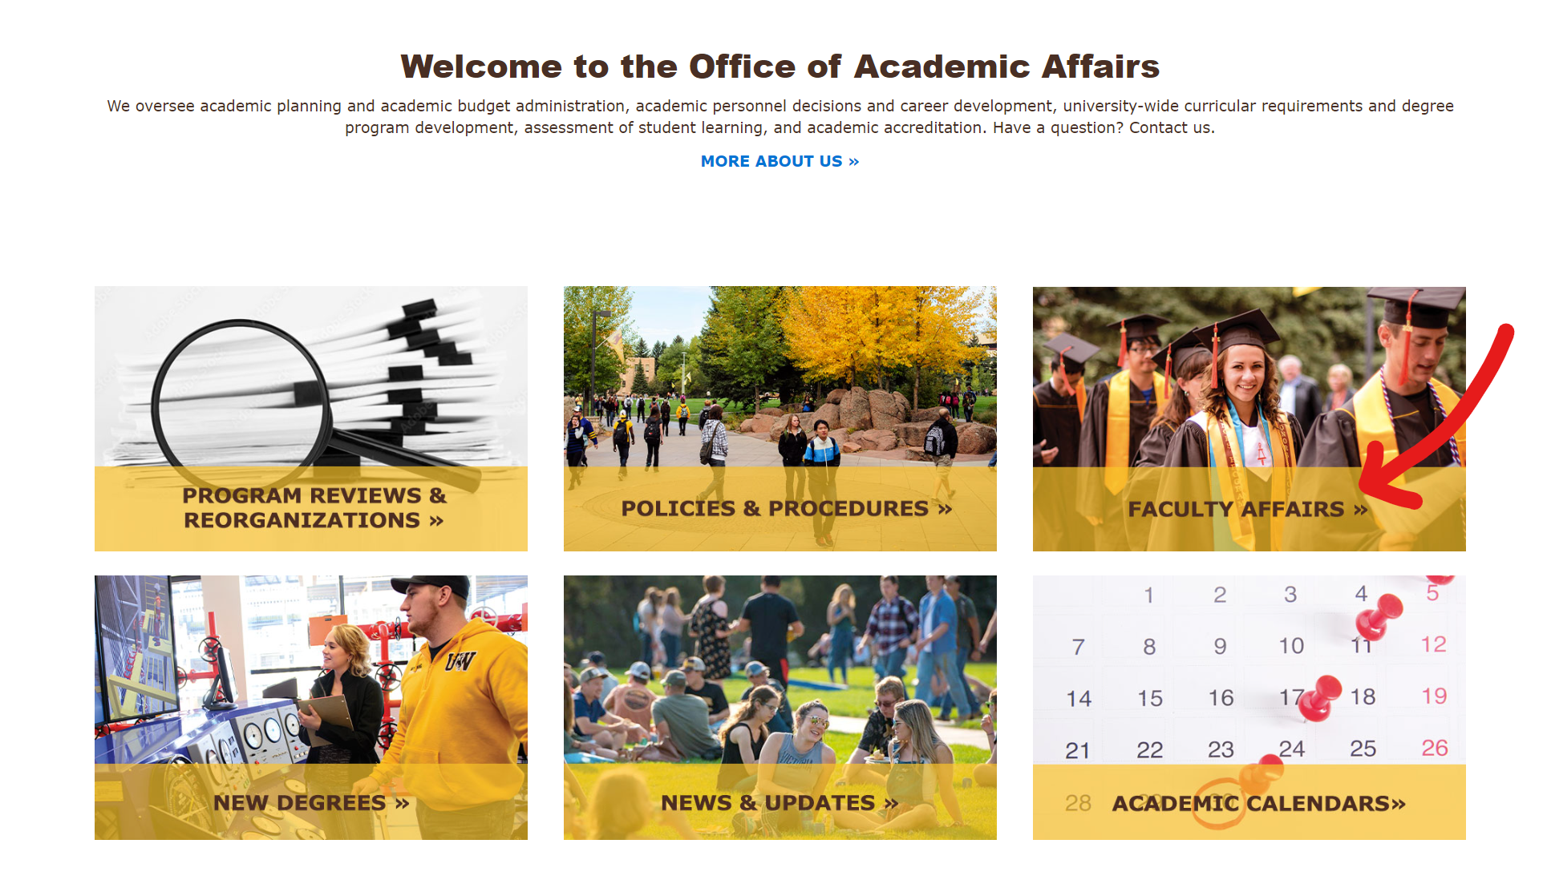

Slide 9
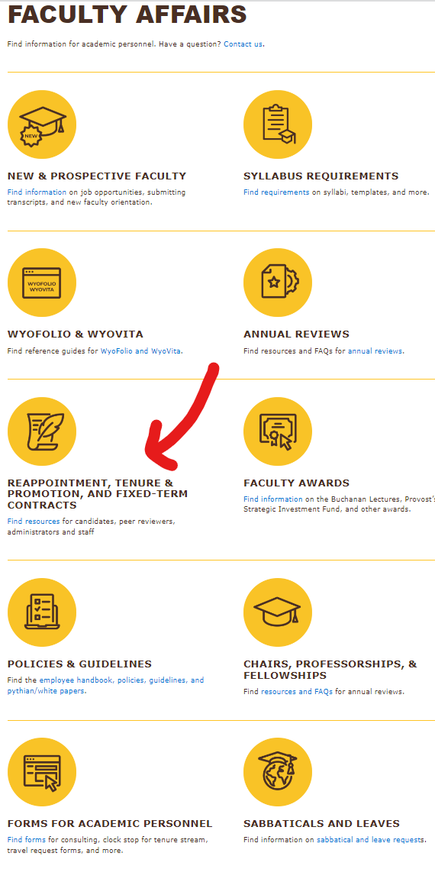
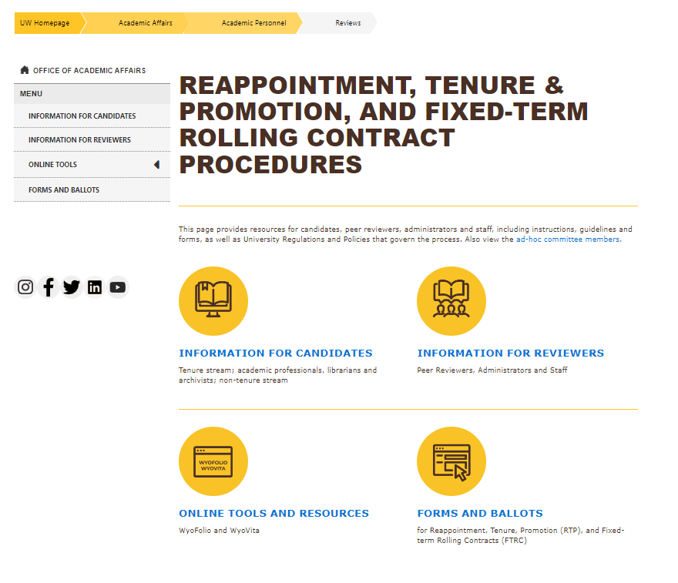

Slide 10
